Slide 1

IR Sensor Car
Arduino with C Programming
ELECTRICAL ENGINEERING AND COMPUTER SCIENCE, COLLEGE OF ENGINEERING AND PHYSICAL SCIENCES
Notes:
Updated 27 Jun 2024 by Noah Mulvaney

Slide 2
Goals
Use an Infrared (IR) Sensor to detect white and black surfaces
Integrate the IR Sensor into the mobile platform so the platform turns when a black line is detected
Fine-tune the IR Sensors to allow the platform to successfully navigate a track

Slide 3
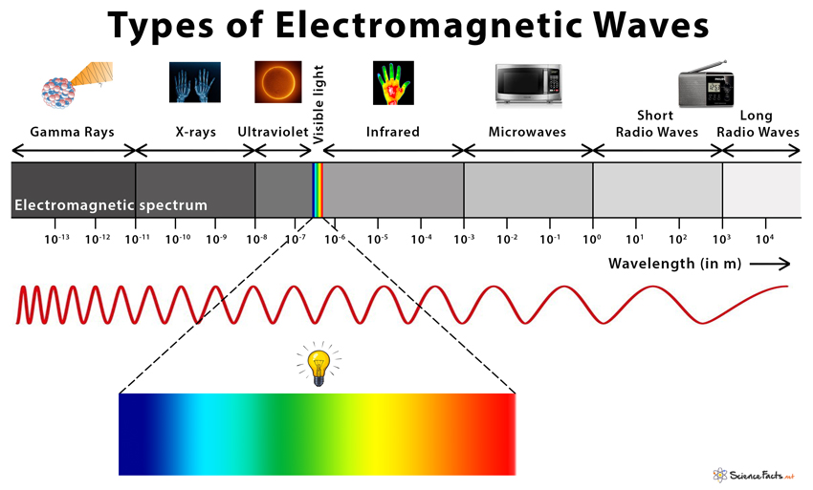
Introduction to Electromagnetic Waves and Infrared Sensors
Infrared light starts just above the red edge of the visible spectrum
  780 nm to 1 mm
White surfaces reflect the maximum amount of infrared light
  The output signal from the IR sensor would be low in this case
Black surfaces reflect a minimal amount of infrared light
  The output signal remains high in this case

Slide 4
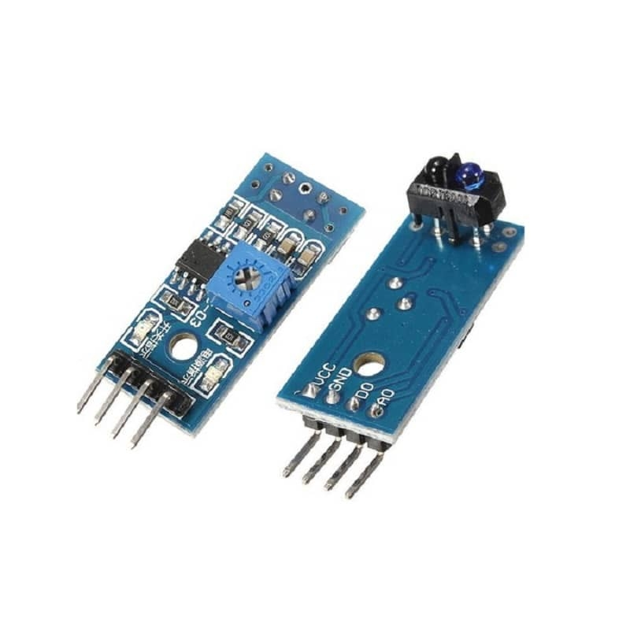
What is an Infrared Sensor?
An electronic sensor that consists of two main parts, an infrared transmitter, and an infrared receiver
Common uses for Infrared Sensors
  Security alarms
  Counting
  Astronomy
  Making mobile platforms go around a track
Notes:
Counting
-Parts on an assembly line
-Rotations of machine parts, think belts and gears

Slide 5
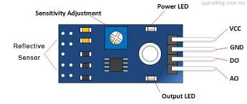
Components of the Infrared Sensor
TCRT5000
  Working Voltage: +5V DC
  Digital Output (DO)
    Transistor-Transistor Logic (TTL) allows for simple communication with digital components such as microcontrollers or computers
  Analog Output (AO)
    Can be used to measure small distances
  Detection Distance: 2cm – 40cm

Slide 6
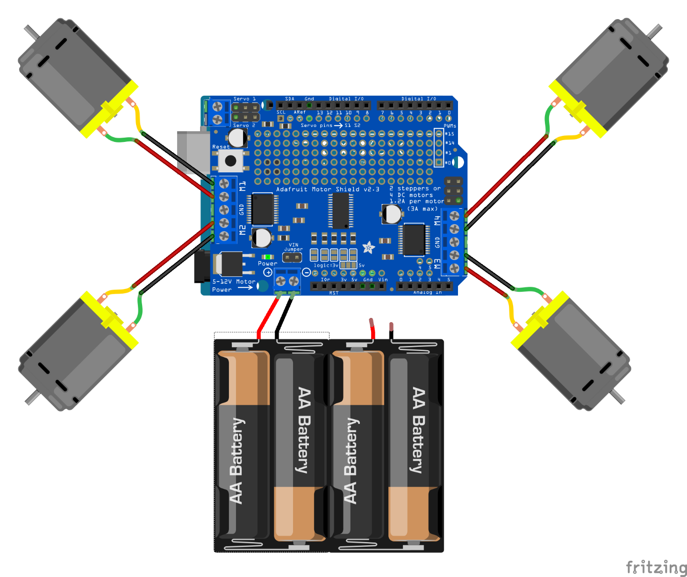
Circuit Diagram Motors
M1 = Front Left Motor
M4 = Rear Right Motor
M2 = Front Right Motor
M3 = Rear Left Motor

Slide 7
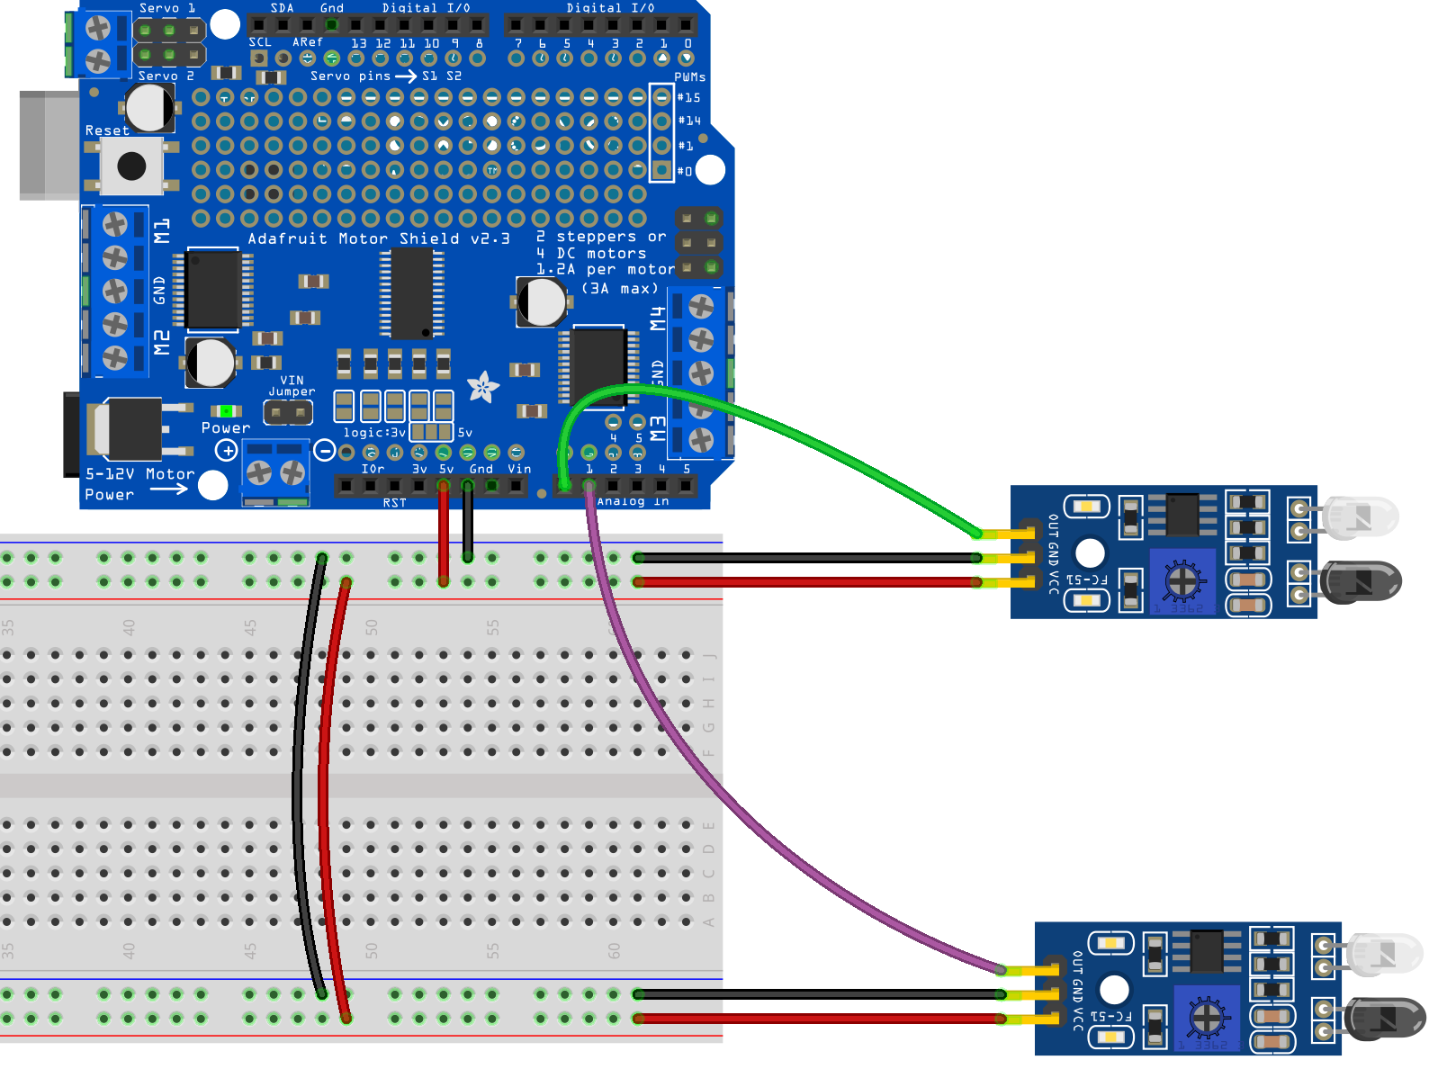
Circuit Diagram IR Sensors
GND
5V
A0
A1
A0
Left IR Sensor
A0
Right IR Sensor

Slide 8
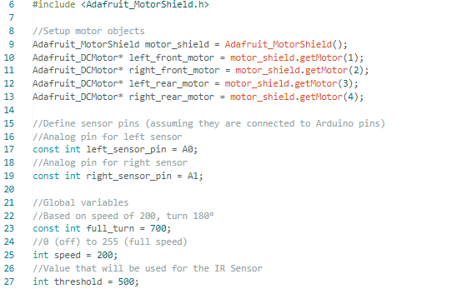

Coding

Slide 9
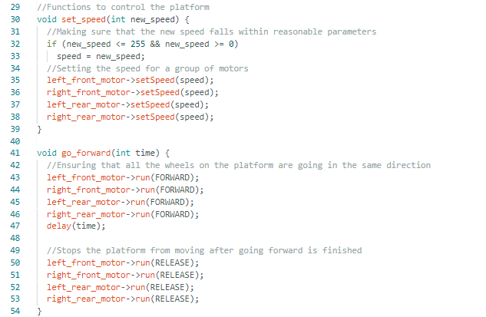

Coding

Slide 10
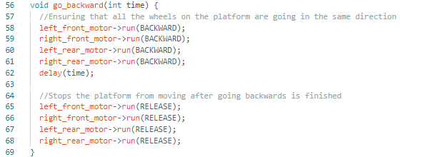
Coding

Slide 11
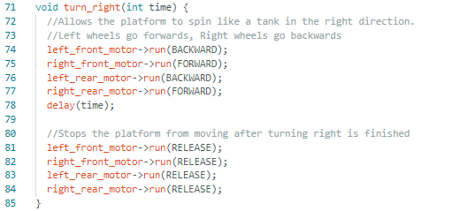
Coding

Slide 12
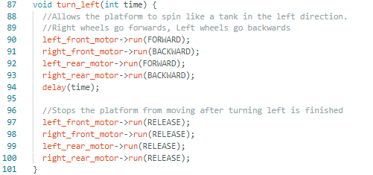
Coding

Slide 13
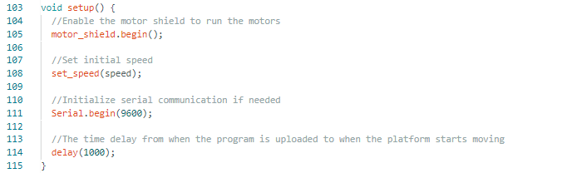
Coding

Slide 14
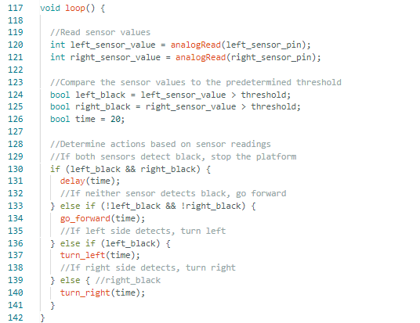
Coding

Slide 15
Coding

Slide 16
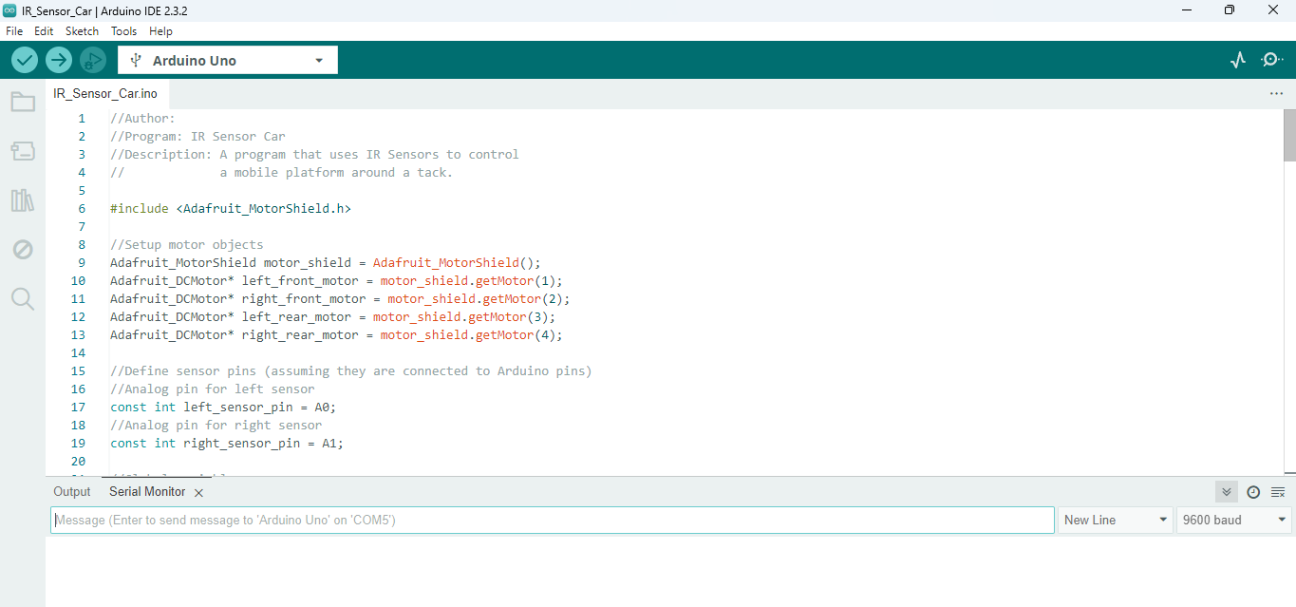
Test it Out!
Run the program
  Click upload to send the code to the Arduino
Adjust the Sensitivity of the IR Sensors and see how many tracks you can get through
Upload
Serial Monitor
Text Display

